Slide 1
Price Scout
TEAM 4LOOP
Notes:
Patrick

Slide 2

Core Functionality
Searching for desired products
Comparing prices
Displaying trends of prices
Notes:
Patrick

Slide 3
Understanding Scope
Setup the following
Change cutting edge tech
API call frequency
Reducing store count
Login using Google
Page navigation
Login
Database
Notes:
Steven

Slide 4


Phase Two System Changes
Cutting Edge Tech
AI
Data Visuals
Notes:
Steven

Slide 5
Potential Improvements
Current
Enhancements
Login function redirects to a new tab.
We would like to make the login integral instead.

Slide 6
UI/UX Page Design
Responsive, user-friendly, minimalistic
How do users interact with the app?
Here are some early sketches compared to our MVP…
Notes:
Justin

Slide 7
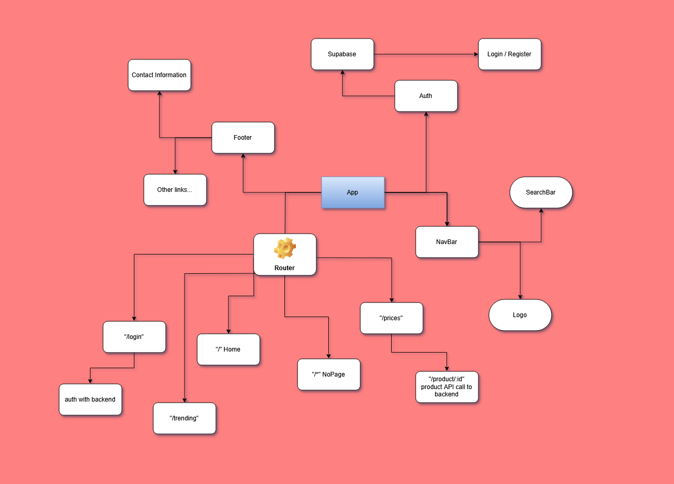

Slide 8
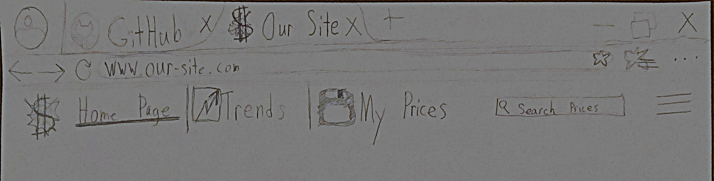
UI/UX progression
Ideation
Notes:
Justin

Slide 9
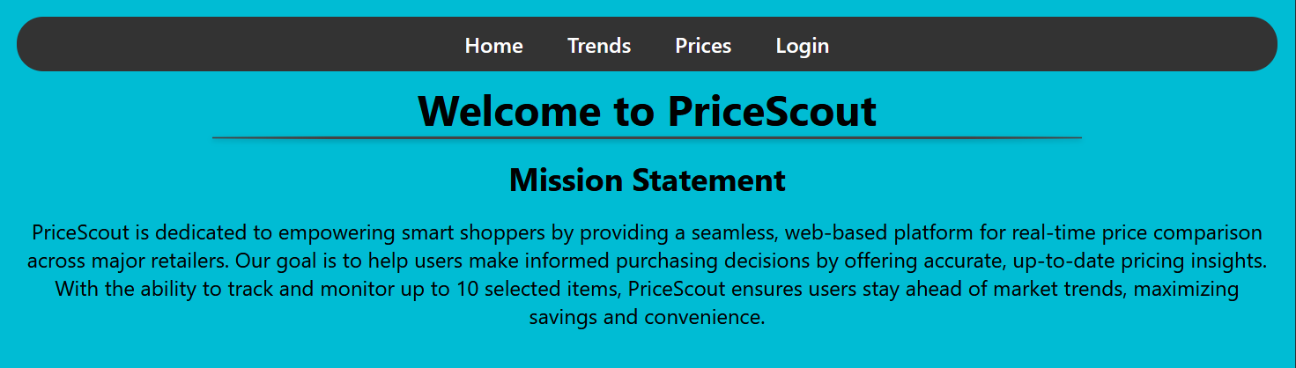
Prototype

Slide 10
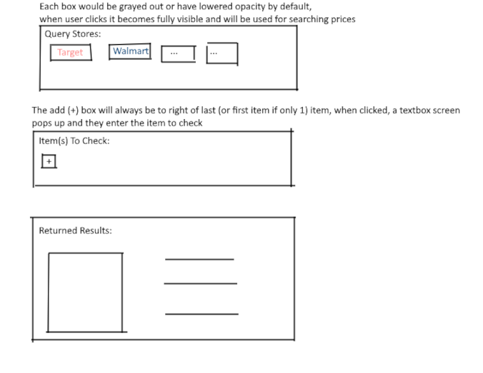
Prototype of Prices Page

Slide 11
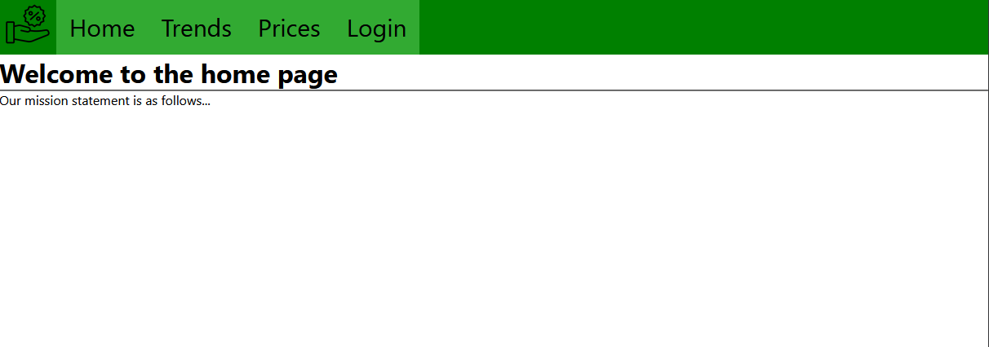

Slide 12
API’s / Technology used
Built in React.js, Initialized with Create-React-App
React-Router-DOM
CORS middleware
Babel (JS compiler)
Webpack (module bundler)
Pure CSS

Slide 13
Data Flow Diagram Steps
User logs in
User searches for products
User interacts with products (e.g., adding to history)
External store sync
Notes:
Steven
1.1 Frontend (Google login) sends authentication data to Supabase Authentication
1.2 Supabase Authentication sends a response back to the Backend API (Django).
1.3 Backend API stores the login data in the Login Table.
2.1 Frontend sends a search query to the Backend API.
2.2 Backend API queries the Products Table and Store_Product_Data Table to fetch the relevant product data.
2.3 The results are sent back to the Frontend for display.
3.1 Backend API stores user-product interaction in the User_Product_History Table.
4.1 Backend API syncs with external stores and stores the API response in the Store_API_Logs and Store_API_Responses Tables.
4.2 The Store_Syncs Table keeps track of when syncs occur.

Slide 14
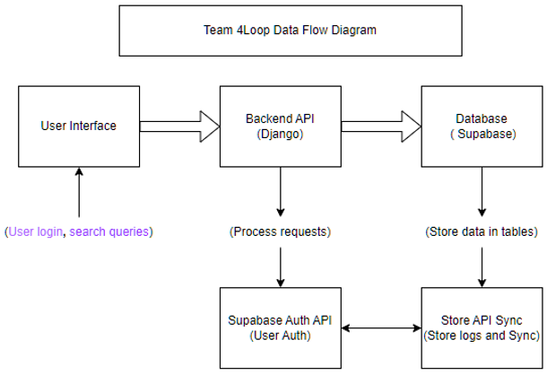
Data Flow Diagram
Notes:
Steven

Slide 15
Thank You
Price-Scout
Notes:
Patrick

